Slide 1

KARLOVY VARY RACE PREVIEW
Elite Analysis · September 12 – 13, 2026
USA Triathlon High Performance

Slide 2
Race Week Schedule
Karlovy Vary
September 12 – 13, 2026 • Lake Rolava (T1) + Theatre Square (T2), Karlovy Vary (CEST, UTC+2)
Sat • Sep 12
Sun • Sep 13 — Women
Sun • Sep 13 — Men
Familiarisation & Briefing
WTCS RACE DAY (AM)
WTCS RACE DAY (PM)
07:30 – 09:30 | Athletes Lounge open — Lake Rolava
07:45 – 08:45 | Swim course familiarisation — Lake Rolava
09:00 | Bike escorted familiarisation
16:00 – 16:30 | ★ Mandatory Elite Athletes briefing — Spa Hotel Thermal
08:00 – 08:30 | Elite Women — TA2 check-in (Theatre Square)
08:30 – 09:30 | Elite Women — Athletes Lounge check-in (re-entry to 09:50)
08:45 – 09:45 | Elite Women — TA1 check-in (Lake Rolava)
09:00 – 09:45 | Elite Women — Swim warm-up
09:50 – 09:59 | Elite Women — Line-up and presentation
10:00 | ★ ELITE WOMEN RACE START
12:10 / 12:25 | Women awards + Chocolate ceremony — Theatre Square
13:00 – 13:30 | Elite Men — TA2 check-in (Theatre Square)
13:30 – 14:30 | Elite Men — Athletes Lounge check-in
13:45 – 14:45 | Elite Men — TA1 check-in (Lake Rolava)
14:00 – 14:45 | Elite Men — Swim warm-up
14:50 – 14:59 | Elite Men — Line-up and presentation
15:00 | ★ ELITE MEN RACE START
17:10 / 17:25 | Men awards + Chocolate ceremony — Theatre Square
Times Lake Rolava (T1) + Theatre Square (T2), Karlovy Vary (CEST, UTC+2). Schedule confirmed from World Triathlon race-info page / athlete guide; subject to organiser updates.

Slide 3
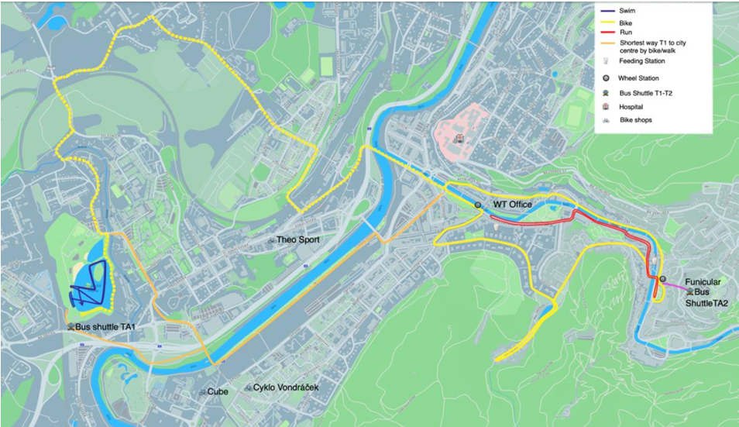
Key Course Differentiators
Karlovy Vary
KARLOVY VARY
COURSE AT A GLANCE
WTCS Karlovy Vary returns to the Czech spa town for its second year at Championship Series level (World Cup 2017–2024, WTCS from 2025). This is a standard-distance, two-transition race: a 1.5 km two-lap swim in Lake Rolava with an Australian exit, a 6.5 km approach into 7 difficult 4.9 km bike laps (40.8 km, with a Cat 4, 1.3 mile climb averaging 4.1%, part cobbled), then a 4-lap 10 km run through the city centre from Theatre Square. The course is the same as the previous year for those racing here again. A technical swim with multiples turns along with a difficult hilly bike is the story here with the course offering strong swim, bikers the opportunity to separate the field and gap the strong runners.
Swim:
1.5 km – 2 laps × 750 m
Bike:
40.8 km – 7 laps × 4.9 km
Run:
10 km – 4 laps × 2.5 km
Format:
Standard Triathlon (WTCS)
Bike Laps:
7
Run Laps:
4
QUICK LINKS
COURSE FEATURES
Current Race Info:
• 1.5 km swim (2 x 750 m) in Lake Rolava. Pontoon start, Australian exit, and navigation heavy. Wetsuit ruling has flipped year to year. Overall, the highly technical course favors strong swimmers
Race Info | 2026 WTCS Karlovy Vary
• 40.8 km bike: 6.5 km approach + 7 x 4.9 km laps. Each lap contains significant cat 4 climb averaging 4.1% grade over 1.35 miles. Cobble section on each lap too
• 10 km run (4 x 2.5 km) through the spa-town centre. Running surface is a mix between asphalt/pavement.
• Two transitions (T1 Lake Rolava to T2 Theatre Square) and split start times: Women 10:00, Men 15:00.

Slide 4
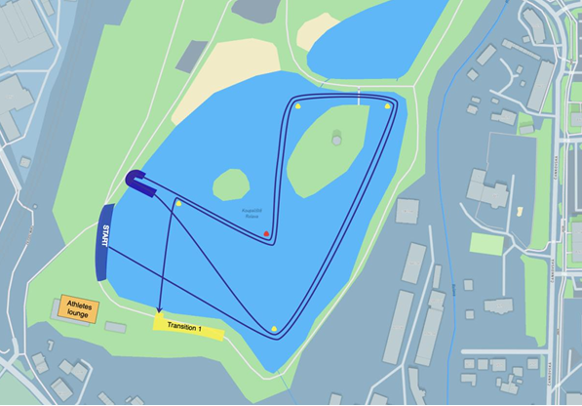
Swim Course Profile
Karlovy Vary
1.5 km • 2 × 750 m
Freshwater lake. Sheltered, island-lined course
Distance
Layout
Start
1.5 km
Lake Rolava
Pontoon start
[Drop swim course map here] Save the organiser map as: ppt files/support/karlovy vary_swim_course.png It will be embedded automatically on the next run.
Water Temp
Wetsuit
Lap Count
18.0–20.0 °C
Likely
2
Tactical Notes
• 2 × 750 m anti-clockwise laps in Lake Rolava. Pontoon start with a hard 205 m opening leg to the first turn buoy. Swim contains an Australian exit at different point than the start. Athletes will run the wooden pier at the end of lap 1 dive back and take a different route to the first bouy
• The swim is navigation-heavy with athletes needing to manage swimming behind the big island, under the bridge, left between the big and small islands, then right to the pier. The water is sheltered with should help make sighting easier than in surf conditions.
Source: 2026 WTCS Karlovy Vary Athletes Guide V5 (Lake Rolava)
• Wetsuit ruling has flipped year to year (18–19 °C most editions, 23–25 °C in 2024) — bring both setups
• Swim exits into TA1 at Lake Rolava; last-minute gear is transported by the LOC to the finish area in the city

Slide 5
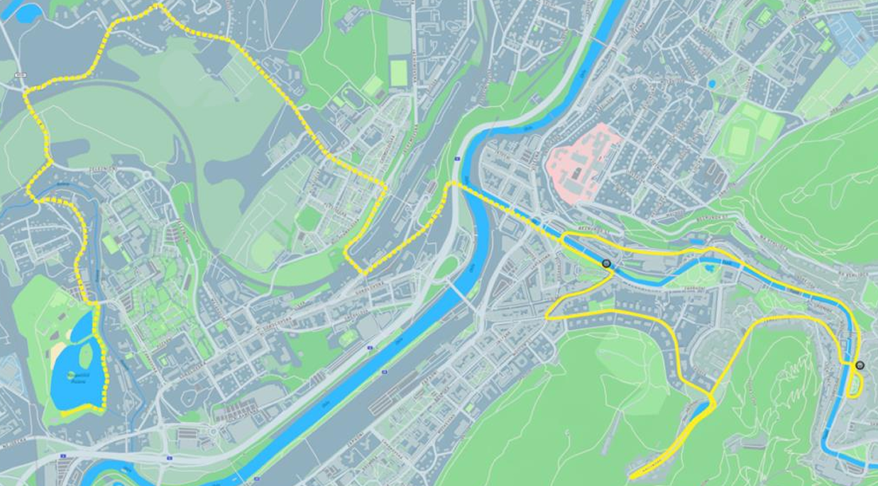
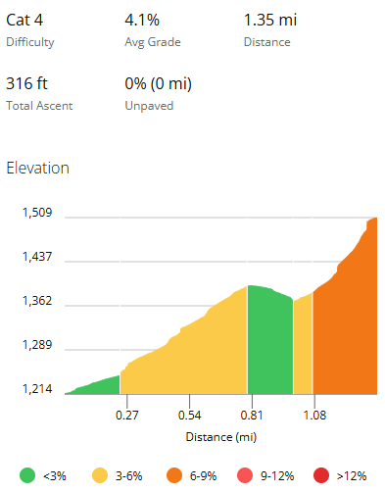
Bike Course Profile
Karlovy Vary
40.8 km • 7 × 4.9 km loops
80% asphalt / 20% pavement (cobbles)
[Drop course map here] Save the organiser course map as: ppt files/support/karlovy vary_bike_course.png It will be embedded automatically on the next run.
Elevation / Lap
Total Climb
Avg Grade
~340 / lap +220 ft on lead in
~ 2,600 ft
~4% (on main climb)
Max Climb Grade
Wind
Loops
6-9%
Sheltered Valley
7 × 4.9 km
Tactical Implications
• 6.5 km approach from Lake Rolava, then 7 technically challenging laps of 4.9 km = 40.8 km total
Source: 2026 WTCS Karlovy Vary Athletes Guide V5 (Lake Rolava to city centre)
• THE defining feature: A 1.35 mile climb repeated 7 time. Average 4.1% and gains 316 ft.
• Corrugated terrain, 80% asphalt / 20% pavement. Some cobbled sections add additional complexity, check tyre pressure and bottles
• One of the hardest bike courses on the circuit: expect the lead group to shrink substantially rather than a bunch finish
• Team wheel station near TA2; neutral wheel station on Nábřeží Osvobození street
Flat course — published profile shows no significant climbs. No elevation chart synthesized; if a race GPS FIT becomes available, real contours will replace this block.
• Saturday escorted familiarisation covers the approach plus 2 laps, with a regroup at the top of the main climb

Slide 6
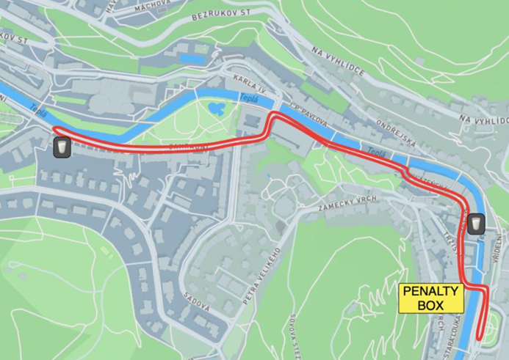
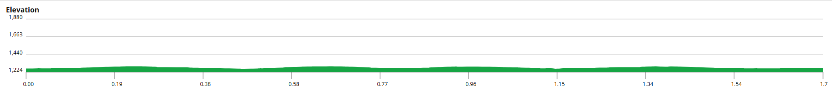
Run Course Profile
Karlovy Vary
10.0 km • 4 × 2.5 km
Mixed asphalt and pavement
Distance
Lap Structure
Total Climb
10.0 km
4 × 2.5 km
~ 400 ft (100 ft / lap)
[Drop run course map here] Save the organiser map as: ppt files/support/karlovy vary_run_course.png It will be embedded automatically on the next run.
Avg Grade
Max ▲ / ▼
Heat Risk
0-3%
Not published
LOW
Tactical Notes
• 4 laps of 2.5 km (10 km) through the Karlovy Vary spa-town centre. Out of TA2 at Theatre Square
• Mixed asphalt and pavement surface.
Source: 2026 WTCS Karlovy Vary Athletes Guide V5 (city centre)
• Mid-September Czech conditions: mild and often cool (historic race-day air 14–27 °C)
• After a brutally selective bike, the run is usually contested by a much-reduced front group

Slide 7
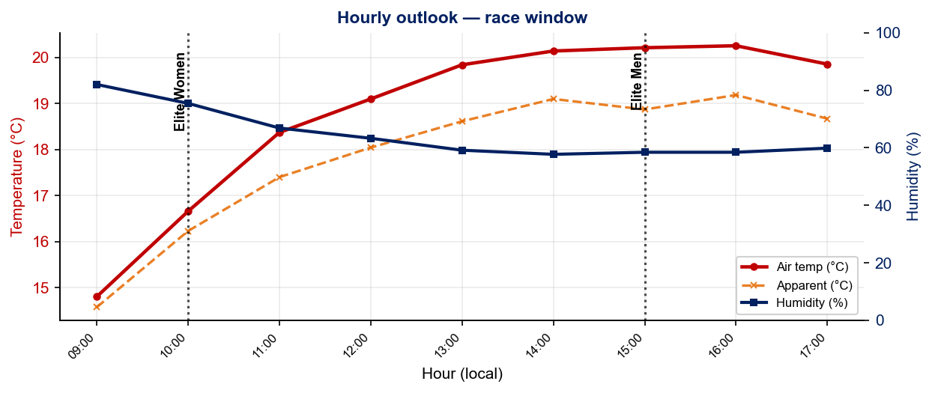
Race-Day Weather Outlook
Karlovy Vary
2026-09-13 • Historical climatology (same calendar day, 7-year mean)
Elite Women — 10:00
Temperature
Apparent / Heat
Humidity
18.0 °C
17.2 °C
69%
Wind
UV peak
Heat Stress
11.1 km/h
—
LOW
Elite Men — 15:00
Temperature
Apparent / Heat
Humidity
20.1 °C
18.9 °C
59%
Wind
UV peak
Heat Stress
11.9 km/h
—
LOW
Hydration & Cooling Cues
• Cool to mild outlook. Standard fluid plan (~500 ml/h)
• Men's race runs 2.1 °C hotter than women’s. Heavier cooling kit may be required for the 15:00 start
Data source: Open-Meteo. Historical Race Conditions slide shows what actually happened in prior years.

Slide 8
Travel & Arrival Load
Denver, CO to Karlovy Vary race week
Core travel read
Fly Denver to Prague (PRG). Roughly 13–15 h door-to-door and a +8 h shift (MDT to CEST). From Prague it is a ~2 h ground transfer to Karlovy Vary (~125 km). The LOC provides a FREE bus transfer for elite athletes and coaches (bike included), but you must email flights to transfer@citytriathlon.cz before 31 Aug 2026 or it becomes 20 EUR a person each way.
Primary route
Flight time
Time zones
Airport Transfer
Transfer Distance
DEN → PRG
~13–15 h
+8 h
PRG → Karlovy Vary
~125 km / ~2 h
1-stop, overnight
via LHR / FRA / AMS
Czechia ahead of Denver
Free LOC bus (register!)
Coach transfer
Accommodation / Venue Logistics Read
Food / Grocery Options
• Briefing is at the Spa Hotel Thermal (Sat 12 Sep, 16:00–16:30)
• Karlovy Vary is a compact spa town. Supermarkets (Billa, Albert, Lidl, Tesco) are an easy walk or short bus from the centre.
• FREE LOC bus PRG to Karlovy Vary: email arrival time + flight number to transfer@citytriathlon.cz before 31 Aug 2026.
• Tap water is safe throughout Czechia; the town's famous mineral springs are drinkable but heavily mineralized. Do not utilize prior to the race.
• Private LOC transfer if you miss the deadline: 140 EUR for 1–3 people, 180 EUR for 4–7. Extra escort staff 20 EUR per person per journey.
• Race-weekend shuttle runs between Divadelní náměstí (T2) and Lake Rolava (T1). About 20 min, with a funicular link at the Imperial stop.
• Czech restaurant staples run heavy (dumplings, pork, sauces). Identify a couple of lighter pasta-and-rice options early in the week.
• Two-transition race: TA2 checks in first (city), then TA1 at the lake.
• Split start times (W 10:00 / M 15:00) mean very different fueling timelines. Men will need to plan out race day meals more carefully
• Free daily 2 h pool access at Mattoni Aréna and run track at AC Start stadium. Bring photo ID.

Slide 9
Environmental Risk Profile
Karlovy Vary
RACE-DAY WEATHER (10:00–17:00 local)
AIR QUALITY (Open-Meteo archive)
Year | Date | Air Temp | Humidity | Wind km/h | Precip mm
2016 | Aug 28 | 25.8 | 52% | 8 | 0.0
2017 | Sep 03 | 14.0 | 59% | 8 | 0.0
2018 | Sep 01 | 15.8 | 60% | 15 | 0.0
2019 | Aug 25 | 24.5 | 59% | 13 | 0.0
2020 | Sep 13 | 21.8 | 50% | 7 | 0.0
2021 | Sep 11 | 18.8 | 81% | 10 | 0.1
2022 | Sep 11 | 16.9 | 60% | 12 | 0.1
2023 | Sep 10 | 27 | 48% | 4 | 0.0
2024 | Sep 08 | 27.5 | 46% | 8 | 0.0
2025 | Sep 14 | 19.3 | 81% | 13 | 0.6
Year | PM2.5 | EU AQI | UV Index | Risk
2016 | 16.8 | 51 | — | Moderate
2017 | 6.5 | 27 | — | Fair
2018 | 9.5 | 24 | — | Fair
2019 | 15.7 | 46 | — | Moderate
2020 | 11.3 | 39 | — | Fair
2021 | 8.9 | 26 | — | Fair
2022 | 6.6 | 26 | 1.3 | Fair
2023 | 11.8 | 53 | 3.7 | Moderate
2024 | 6.7 | 33 | 3.3 | Fair
2025 | 1.9 | 22 | 1.3 | Fair
Weather and AQ data: Open-Meteo historical archive (archive-api.open-meteo.com). EU AQI: Good ≤20, Fair ≤40, Moderate ≤60, Poor ≤80, Very Poor >80.

Slide 10
Who to Watch — Karlovy Vary Race Week
ELITE MEN
ELITE WOMEN
Top 10 Ranked on Startlist
Top 10 Ranked on Startlist
Rank | Athlete | Points
2 | Miguel Hidalgo | 6,742
3 | Vasco Vilaca | 6,632
4 | Henry Graf | 6,009
5 | Csongor Lehmann | 5,281
6 | David Cantero Del Campo | 5,092
8 | Dorian Coninx | 4,423
9 | Ricardo Batista | 4,055
10 | Charles Paquet | 3,998
12 | Oliver Conway | 3,682
15 | Tjebbe Kaindl | 3,293
Rank | Athlete | Points
1 | Beth Potter | 7,276
2 | Lisa Tertsch | 7,270
4 | Jeanne Lehair | 6,306
6 | Cassandre Beaugrand | 5,391
7 | Jolien Vermeylen | 5,167
9 | Taylor Spivey | 5,091
10 | Diana Isakova | 4,750
11 | Tanja Neubert | 4,583
12 | Bianca Seregni | 4,437
13 | Georgia Taylor-Brown | 3,728
Returning Podium Athletes on Startlist
Returning Podium Athletes on Startlist
1. Henry Graf (01:49:22)
1. Beth Potter (02:02:12)
2. Miguel Hidalgo (01:49:29)
2. Taylor Spivey (02:02:25)
3. Csongor Lehmann (01:49:46)
3. Lisa Tertsch (02:03:07)
Rankings = current World Triathlon rankings snapshot; startlist intersect uses program_entries when available.

Slide 11
Top Swim Threats
Karlovy Vary
Ranked by Lead Pack % (within 15 s of swim leader — robust to course speed) • EWMA swim split (span-5) shown per distance; Standard = this race • WTCS / World Cup / Continental, last 4 yrs
ELITE MEN
ELITE WOMEN
# | Athlete | Lead % | EWMA Spr | EWMA Std ▸ | Spr/Std
1 | Alessio Crociani | 100% | 8:39 | 17:19 | 17/4
2 | Dorian Coninx | 100% | 8:58 | 17:26 | 5/9
3 | Márk Dévay | 97% | 8:50 | 17:12 | 9/24
4 | Miguel Tiago Silva | 95% | 8:58 | 17:30 | 8/13
5 | Henry Graf | 88% | 8:56 | 17:31 | 11/5
6 | Csongor Lehmann | 86% | 8:37 | 17:27 | 5/16
7 | Tayler Reid | 85% | 8:51 | 17:11 | 13/14
8 | Max Stapley | 85% | 8:50 | 17:38 | 10/10
9 | Márton Kropkó | 80% | 8:56 | 17:47 | 2/3
10 | Chase McQueen | 77% | 9:04 | 18:02 | 9/13
11 | Jules Rethoret | 69% | 8:48 | 17:53 | 9/4
12 | Kenji Nener | 69% | 8:55 | 18:16 | 11/15
13 | Miguel Hidalgo | 67% | 8:50 | 17:39 | 7/14
14 | Maciej Bruzdziak | 67% | 8:52 | 17:57 | 8/16
# | Athlete | Lead % | EWMA Spr | EWMA Std ▸ | Spr/Std
1 | Bianca Seregni | 93% | 9:02 | 19:03 | 8/20
2 | Cassandre Beaugrand | 87% | 9:50 | 19:42 | 5/10
3 | Olivia Mathias | 78% | 9:45 | 18:58 | 13/10
4 | Erin McConnell | 77% | 9:28 | — | 13/0
5 | Sophia Howell | 74% | 9:49 | 19:46 | 26/8
6 | Márta Kropkó | 73% | 9:38 | 18:46 | 12/10
7 | Jolien Vermeylen | 72% | 9:07 | 18:41 | 18/18
8 | Taylor Spivey | 68% | 9:44 | 19:14 | 5/14
9 | Sian Rainsley | 67% | 9:49 | 19:15 | 10/11
10 | Laura Lindemann | 62% | 9:44 | 19:26 | 4/12
11 | Eva Goodisson | 61% | 10:25 | 19:33 | 17/11
12 | Beth Potter | 60% | 9:56 | 19:25 | 5/15
13 | Therese Feuersinger | 57% | 9:51 | 18:53 | 14/9
14 | Jessica Fullagar | 56% | 9:41 | 19:38 | 8/8

Slide 12
USA World Rankings Snapshot
Karlovy Vary
As of 2026-08-17 • World Triathlon Rankings • Heading into Karlovy Vary • Race tier: WTCS
Max Points Available at this Race
Win
Podium
Top 5
Top 10
Top 15
Top 20
1,000 pts
855 pts
732 pts
495 pts
335 pts
227 pts
ELITE MEN
ELITE WOMEN
Rank | Athlete | Points | Curr | Prev
20 | John Reed | 2,898 | 6 | 6
22 | Reese Vannerson | 2,818 | 6 | 6
27 | Morgan Pearson | 2,680 | 5 | 4
42 | Braxton Legg | 2,442 | 6 | 6
49 | Sullivan Middaugh | 2,296 | 6 | 6
53 | Seth Rider | 2,243 | 6 | 4
67 | Keller Norland | 1,989 | 6 | 6
80 | Blake Bullard | 1,732 | 6 | 6
84 | Chase McQueen | 1,708 | 6 | 6
108 | Porter Middaugh | 1,513 | 6 | 6
113 | Darr Smith | 1,452 | 6 | 6
116 | Zach Leachman | 1,433 | 6 | —
178 | Carter Stuhlmacher | 1,025 | 6 | 3
282 | Cole Jamieson | 600 | 4 | 2
362 | Isaac Lamprecht | 417 | 6 | 2
Rank | Athlete | Points | Curr | Prev
9 | Taylor Spivey | 5,091 | 6 | 3
16 | Gina Sereno | 3,205 | 6 | 6
26 | Danielle Orie | 2,741 | 6 | 6
27 | Gwen Jorgensen | 2,700 | 6 | 6
42 | Erika Ackerlund | 2,341 | 6 | 6
46 | Kelly Wetteland | 2,109 | 6 | 3
51 | Taylor Knibb | 2,047 | 4 | —
60 | Naomi Ruff | 1,968 | 6 | 6
89 | Kirsten Kasper | 1,551 | 5 | 2
93 | Eleanor Beveridge | 1,479 | 6 | 5
100 | Joy Gill | 1,421 | 6 | 6
113 | Rachel Werking | 1,328 | 6 | 3
131 | Michelle Magnani | 1,242 | 6 | 6
162 | Katie McCune | 1,042 | 6 | 1
174 | Faith Duncan | 940 | 6 | —

Slide 13
Olympic Qualification Pace
Karlovy Vary
Paris 2024 OQR cutoff (30th): 3,626.69 pts ÷ 12-event cap = 302 pts / event on pace
An athlete who averages ~302 pts per event across their best 12 events is on pace to clear the LA 2028 qualifying threshold.
FINISH POSITION AT EACH TIER THAT HITS 302-PT PACE
Tier | Win pts | Last on-pace pos | First off-pace pos (pts) | Verdict
World Championship Series | 1000 | #16 | #17 (287 pts) | Top 16
World Cup | 500 | #7 | #8 (290 pts) | Top 7
USA MEN
USA WOMEN
Rk | Athlete | Total | Races | On | Off | Pace | Proj @12
12 | Sullivan Middaugh | 1,573 | 5 | 2 | 3 | 314 | 3,776
16 | Reese Vannerson | 1,479 | 4 | 3 | 1 | 369 | 4,439
19 | Seth Rider | 1,341 | 4 | 3 | 1 | 335 | 4,023
20 | Braxton Legg | 1,274 | 4 | 2 | 2 | 318 | 3,823
24 | Keller Norland | 1,087 | 3 | 2 | 1 | 362 | 4,349
36 | Morgan Pearson | 904 | 2 | 1 | 1 | 452 | 5,425
41 | Chase McQueen | 816 | 4 | 1 | 3 | 204 | 2,450
60 | John Reed | 599 | 2 | 1 | 1 | 299 | 3,598
66 | Blake Bullard | 513 | 3 | 0 | 3 | 171 | 2,055
68 | Porter Middaugh | 481 | 3 | 1 | 2 | 160 | 1,926
107 | Zach Leachman | 212 | 1 | 0 | 1 | 212 | 2,545
Rk | Athlete | Total | Races | On | Off | Pace | Proj @12
9 | Taylor Knibb | 2,047 | 4 | 4 | 0 | 511 | 6,142
13 | Taylor Spivey | 1,795 | 3 | 3 | 0 | 598 | 7,180
15 | Danielle Orie | 1,646 | 5 | 3 | 2 | 329 | 3,951
16 | Gina Sereno | 1,450 | 4 | 2 | 2 | 362 | 4,351
28 | Kelly Wetteland | 925 | 2 | 2 | 0 | 462 | 5,550
32 | Naomi Ruff | 882 | 3 | 1 | 2 | 294 | 3,530
45 | Erika Ackerlund | 720 | 3 | 1 | 2 | 240 | 2,882
56 | Eleanor Beveridge | 567 | 3 | 0 | 3 | 189 | 2,269
58 | Gwen Jorgensen | 556 | 2 | 1 | 1 | 278 | 3,337
91 | Rachel Werking | 271 | 2 | 0 | 2 | 135 | 1,629
110 | Joy Gill | 200 | 2 | 0 | 2 | 100 | 1,203
On = events scoring ≥ pace. Off = events < pace. Pace = total breakdown pts ÷ events raced. Proj @12 = current total + (avg pts × remaining events to cap); green if ≥ Paris cutoff. Cutoff estimate: Paris 2024 = 3,627 pts / 12 events = 302 pts/event. Tier positions use a geometric 0.925 points model. Source: World Triathlon rankings database.

Slide 14
ELITE MEN

Slide 15
Race Overview — Elite Men
Karlovy Vary
RACE HISTORY AT KARLOVY VARY
3 KEYS TO SUCCESS
The Elite Men race at Karlovy Vary has been held 10 times in this analysis window (2016–2025). The event was previously part of the Continental Cup / World Cup calendar until being added to the series in 2025.
Last year, Henry Graf was able to leverage his strong bike skills to break up the field and separate himself from the strong runners which ultimately resulted in him holding off Hidalgo for the win.
Athletes competing this year should again expect the strong swim/bikers to leverage a technical swim and hilly bike course to break the field up and make this one of the hardest races on the circuit. Don’t be surprised if a quarter of the field doesn’t make it to the finish. 15 athletes were either lapped out or DNF’d in last years race, confirming the difficulty of the course.
1
Course was short was year with the average time for the standard distance at 15:58. However when the course was on the World Cup circuit, the technical nature navigating the islands and Auzzie exit often strung out the field and resulted in less than 10 athletes coming out near the leader. Expect for strong swimmers to get out and try to break the pack before lap 1 ends.
2
Since the course has been changed to its current format the pack has often split up because of the hilly and demanding course profile. In the past 3 editions of the race the lead pack was condensed even further to small groups of 3, 5, and 1 riders, respectively. Expect for strong cyclists to attack the group and split the field up.
3
With the race being a WTCS last year and a slight course change, the 10K times were significantly faster than in previous years. Despite the difficult bike leg, average run times from 2025 were very similar to Yokohama with the difference from the two races only 1 second apart. Thus, if you can manage the hills on the bike, the flat run course should still suit fast runners the opportunity to close on the field.

Slide 16
Results Summary — Elite Men
Karlovy Vary
Year | Date | Category | Field | DNF/LAP/DNS | Winner | Winner Time | Air Temp | Water Temp | Swim km | Bike km | Run km
2016 | Aug 28 | Continental Cup | 49 | 24 | Brownlee | 1:50:34 | 25.8 | — | — | — | —
2017 | Sep 03 | World Cup | 50 | 12 | Iden | 1:49:06 | 14.0 | — | — | — | —
2018 | Sep 01 | World Cup | 62 | 12 | Polyanskiy | 1:52:22 | 15.8 | — | — | — | —
2019 | Aug 25 | World Cup | 66 | 21 | Dickinson | 1:56:11 | 24.5 | — | — | — | —
2020 | Sep 13 | World Cup | 66 | 19 | Luis | 1:52:14 | 21.8 | — | — | — | —
2021 | Sep 11 | World Cup | 65 | 12 | Priester | 1:53:31 | 18.8 | — | — | — | —
2022 | Sep 11 | World Cup * | 66 | 15 | Lehmann | 1:51:10 | 16.9 | — | 1.50 | 40.8 | 10.0
2023 | Sep 10 | World Cup | 59 | 20 | Pearson | 1:51:55 | 27 | 19.8 | 1.50 | 40.8 | 10.0
2024 | Sep 08 | World Cup * | 52 | 8 | Reed | 1:54:24 | 27.5 | 24.9 | 1.50 | 40.8 | —
2025 | Sep 14 | World Championship Series * | 51 | 15 | Graf | 1:49:22 | 19.3 | 18.0 | 1.50 | 40.8 | 10.0
* Course distance changed vs. prior year

Slide 17
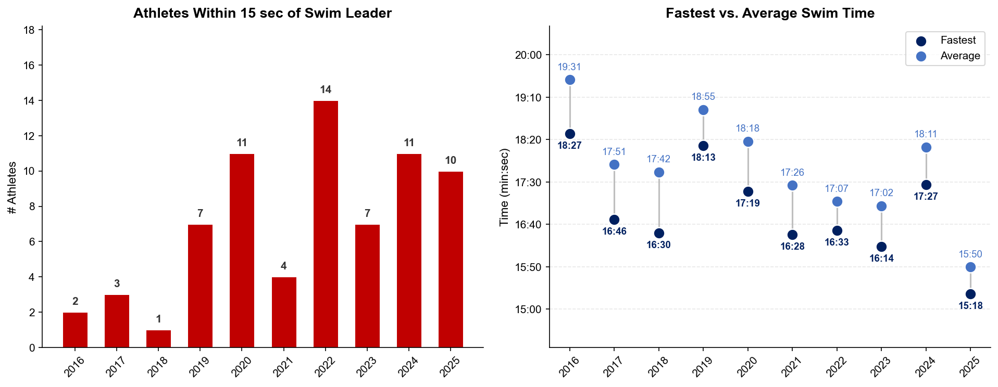
Swim Exit Dynamics — Elite Men
Karlovy Vary

Slide 18
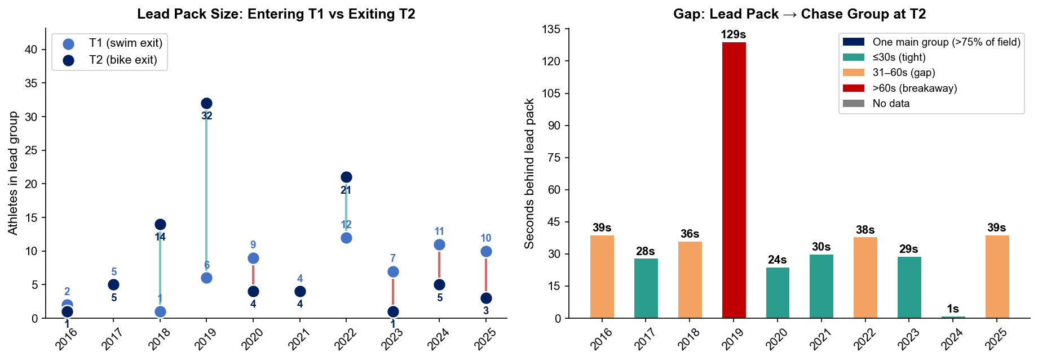
Bike Pack Evolution — Elite Men
Karlovy Vary
Lead pack = athletes within 15 sec of leader. T1 = lead group entering the bike; T2 = lead group exiting the bike.
Year | Lead Size @ T1 | Lead Size @ T2 | Change | Chase Group @ T2 | Chase Gap*
2016 | 2 | 1 | -1 | 1 | 39s
2017 | 5 | 5 | 0 | 4 | 28s
2018 | 1 | 14 | +13 | 12 | 36s
2019 | 6 | 32 | +26 | 2 | 129s
2020 | 9 | 4 | -5 | 1 | 24s
2021 | 4 | 4 | 0 | 24 | 30s
2022 | 12 | 21 | +9 | 21 | 38s
2023 | 7 | 1 | -6 | 9 | 29s
2024 | 11 | 5 | -6 | 18 | 1s
2025 | 10 | 3 | -7 | 25 | 39s
Lead pack = athletes within 15 sec of leader. Chase group = athletes within 15 sec of the first athlete outside the lead pack. * Chase Gap = seconds from the last lead-pack athlete to the first chase-group athlete at T2.

Slide 19
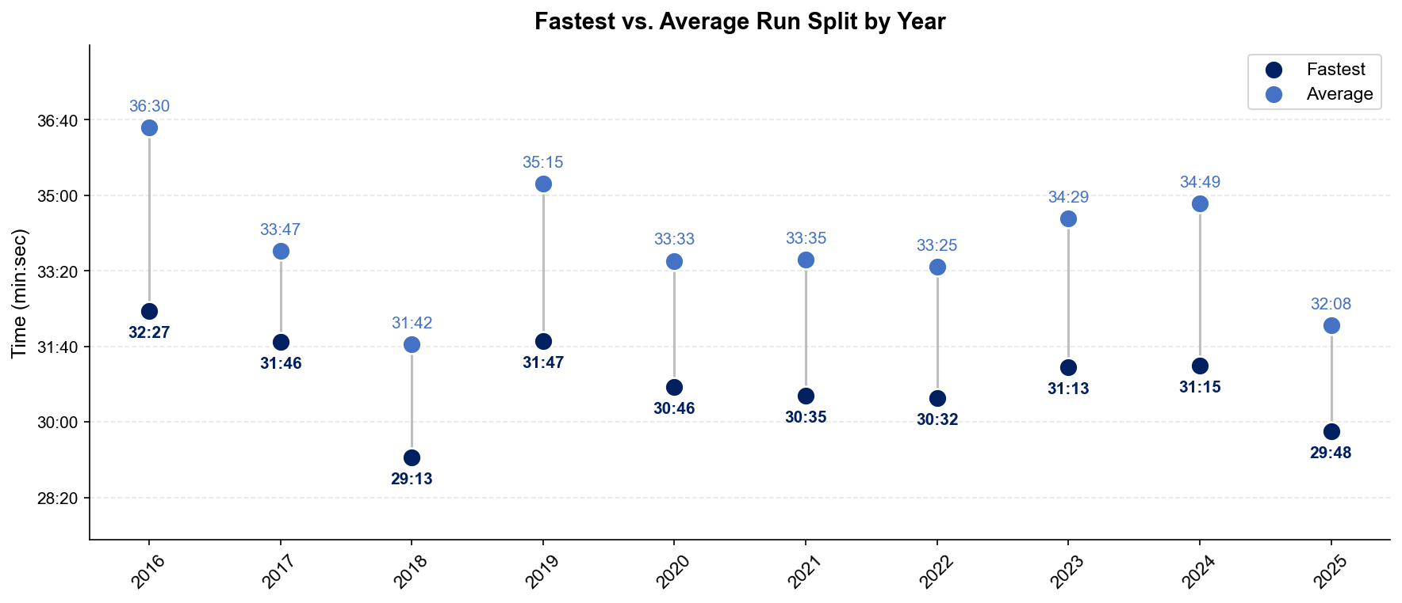
Run Split Analysis — Elite Men
Karlovy Vary

Slide 20
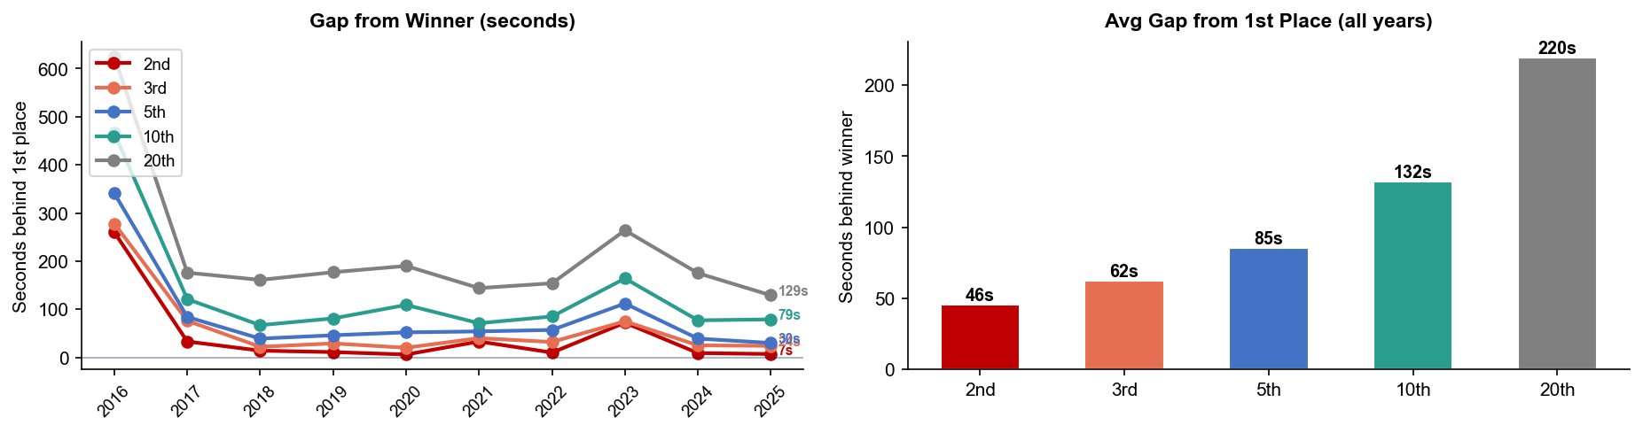
Key Position Times — Elite Men
Karlovy Vary
Year | 1st | 2nd | 3rd | 5th | 10th | 20th
2016 | 1:50:34 | 1:54:54 +260s | 1:55:12 +278s | 1:56:15 +341s | 1:58:20 +466s | 2:00:59 +625s
2017 | 1:49:06 | 1:49:39 +33s | 1:50:22 +76s | 1:50:30 +84s | 1:51:07 +121s | 1:52:02 +176s
2018 | 1:52:22 | 1:52:36 +14s | 1:52:44 +22s | 1:53:01 +39s | 1:53:29 +67s | 1:55:03 +161s
2019 | 1:56:11 | 1:56:22 +11s | 1:56:40 +29s | 1:56:57 +46s | 1:57:32 +81s | 1:59:08 +177s
2020 | 1:52:14 | 1:52:20 +6s | 1:52:34 +20s | 1:53:06 +52s | 1:54:03 +109s | 1:55:24 +190s
2021 | 1:53:31 | 1:54:04 +33s | 1:54:11 +40s | 1:54:25 +54s | 1:54:42 +71s | 1:55:55 +144s
2022 | 1:51:10 | 1:51:20 +10s | 1:51:42 +32s | 1:52:07 +57s | 1:52:35 +85s | 1:53:44 +154s
2023 | 1:51:55 | 1:53:07 +72s | 1:53:10 +75s | 1:53:47 +112s | 1:54:39 +164s | 1:56:19 +264s
2024 | 1:54:24 | 1:54:33 +9s | 1:54:49 +25s | 1:55:03 +39s | 1:55:41 +77s | 1:57:19 +175s
2025 | 1:49:22 | 1:49:29 +7s | 1:49:46 +24s | 1:49:52 +30s | 1:50:41 +79s | 1:51:31 +129s

Slide 21
Race Conditions — Elite Men
Karlovy Vary
Year | Date | Air Temp | Humidity | Wind (km/h) | Precip (mm) | Water Temp | Wetsuit | Conditions
2016 | Aug 28 | 25.8 | 52% | 8 | 0.0 | — | — | —
2017 | Sep 03 | 14.0 | 59% | 8 | 0.0 | — | — | —
2018 | Sep 01 | 15.8 | 60% | 15 | 0.0 | — | — | —
2019 | Aug 25 | 24.5 | 59% | 13 | 0.0 | — | — | —
2020 | Sep 13 | 21.8 | 50% | 7 | 0.0 | — | — | —
2021 | Sep 11 | 18.8 | 81% | 10 | 0.1 | — | — | —
2022 | Sep 11 | 16.9 | 60% | 12 | 0.1 | — | allowed | —
2023 | Sep 10 | 27 | 48% | 4 | 0.0 | 19.8 | allowed | —
2024 | Sep 08 | 27.5 | 46% | 8 | 0.0 | 24.9 | forbidden | —
2025 | Sep 14 | 19.3 | 81% | 13 | 0.6 | 18.0 | allowed | —
Air temp, humidity, wind, and precipitation sourced from Open-Meteo historical archive (race window 10:00–17:00 local) where WT API data is absent. Values marked * are Open-Meteo estimates. Water temp and wetsuit ruling are from the World Triathlon API per program.

Slide 22
ELITE WOMEN

Slide 23
Race Overview — Elite Women
Karlovy Vary
RACE HISTORY AT KARLOVY VARY
3 KEYS TO SUCCESS
The Elite Women race at Karlovy Vary has been held 10 times in this analysis window (2016–2025). Beth Potter won the first WTCS edition here last year, coming from behind off the bike to close on the breakaway and take the win with the fastest run split of 32:42. Athletes competing here should expect for the strong swim/bikers to again put the pace on early with the hopes of dropping fast runners like Potter. However, those in the breakaway, should keep in mind the matches they are burning on the repeated climbs and how that will affect their run legs. While significant time can be made on the bike here, the flat run course offers the talented runners an opportunity to chase down athletes who may have over biked.
1
Course was short was year with the average time for the standard distance at 17:40. Again, the technical requirements of navigating around an island and bridge along with the Auzzie exit has often strung out the field and resulted in only 5-10 coming out of the water close to the lead.
2
Like the men’s races, strong swim bikers in the women’s race have also historically used the hilly course to further separate the field. However, where the men’s chase group has held the gap relatively close, it has ballooned more so on the women’s side. Don’t be surprised if a group of less than 5 women are able to put multiple minutes into just the first chase group at T2.
3
The fast and flat run course has suited the top women here. Beth Potter, the ‘25 winner, ran a 32:42 last year, which was nearly a minute faster than the winner at Yokohama who ran a 33:38. Thus while the race is difficult, the flat urban roads do offer the top runners a great opportunity to pass those who override the bike.

Slide 24
Results Summary — Elite Women
Karlovy Vary
Year | Date | Category | Field | DNF/LAP/DNS | Winner | Winner Time | Air Temp | Water Temp | Swim km | Bike km | Run km
2016 | Aug 28 | Continental Cup | 28 | 6 | Yelistratova | 2:07:22 | 25.8 | — | — | — | —
2017 | Sep 03 | World Cup | 26 | 3 | Backhouse | 2:03:29 | 14.0 | — | — | — | —
2018 | Sep 01 | World Cup | 46 | 16 | Frintova | 2:08:22 | 15.8 | — | — | — | —
2019 | Aug 25 | World Cup | 55 | 13 | Frintova | 2:09:08 | 24.5 | — | — | — | —
2020 | Sep 13 | World Cup | 54 | 19 | Duffy | 2:05:17 | 21.8 | — | — | — | —
2021 | Sep 11 | World Cup | 50 | 17 | Derron | 2:06:56 | 18.8 | — | — | — | —
2022 | Sep 11 | World Cup * | 53 | 12 | Periault | 2:05:04 | 16 | 19.1 | 1.50 | 40.8 | 10.0
2023 | Sep 10 | World Cup | 43 | 8 | Jorgensen | 2:03:51 | 23.6 | 19 | 1.50 | 40.8 | 10.0
2024 | Sep 08 | World Cup * | 27 | 2 | Kingma | 2:05:23 | 19.8 | 23.2 | 1.50 | 40.8 | —
2025 | Sep 14 | World Championship Series * | 39 | 10 | Potter | 2:02:12 | 14.6 | 18.1 | 1.50 | 40.8 | 10.0
* Course distance changed vs. prior year

Slide 25
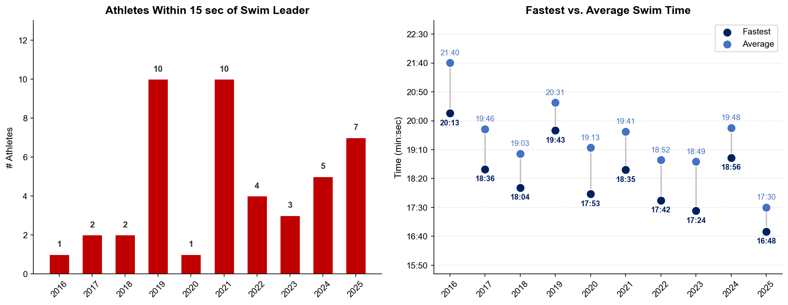
Swim Exit Dynamics — Elite Women
Karlovy Vary

Slide 26
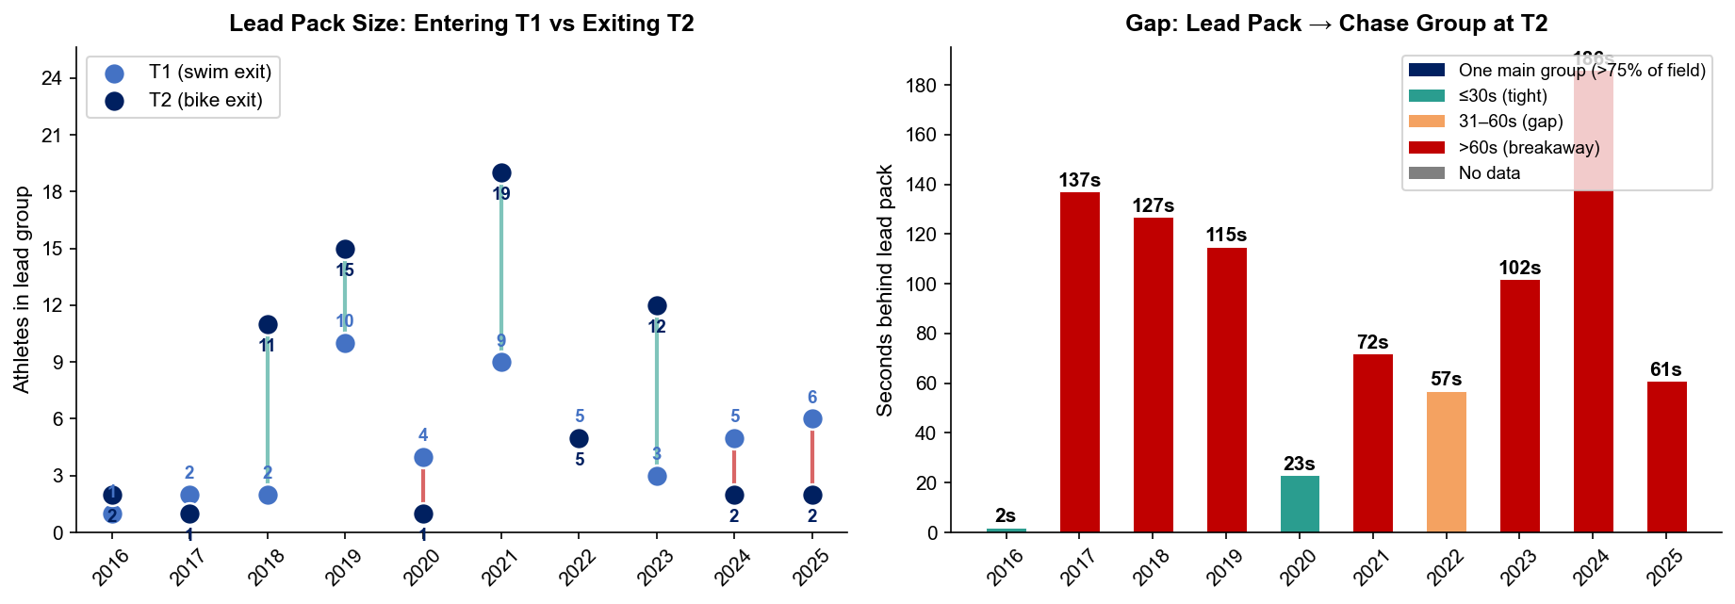
Bike Pack Evolution — Elite Women
Karlovy Vary
Lead pack = athletes within 15 sec of leader. T1 = lead group entering the bike; T2 = lead group exiting the bike.
Year | Lead Size @ T1 | Lead Size @ T2 | Change | Chase Group @ T2 | Chase Gap*
2016 | 1 | 2 | +1 | 14 | 2s
2017 | 2 | 1 | -1 | 12 | 137s
2018 | 2 | 11 | +9 | 1 | 127s
2019 | 10 | 15 | +5 | 16 | 115s
2020 | 4 | 1 | -3 | 6 | 23s
2021 | 9 | 19 | +10 | 3 | 72s
2022 | 5 | 5 | 0 | 18 | 57s
2023 | 3 | 12 | +9 | 14 | 102s
2024 | 5 | 2 | -3 | 11 | 186s
2025 | 6 | 2 | -4 | 10 | 61s
Lead pack = athletes within 15 sec of leader. Chase group = athletes within 15 sec of the first athlete outside the lead pack. * Chase Gap = seconds from the last lead-pack athlete to the first chase-group athlete at T2.

Slide 27
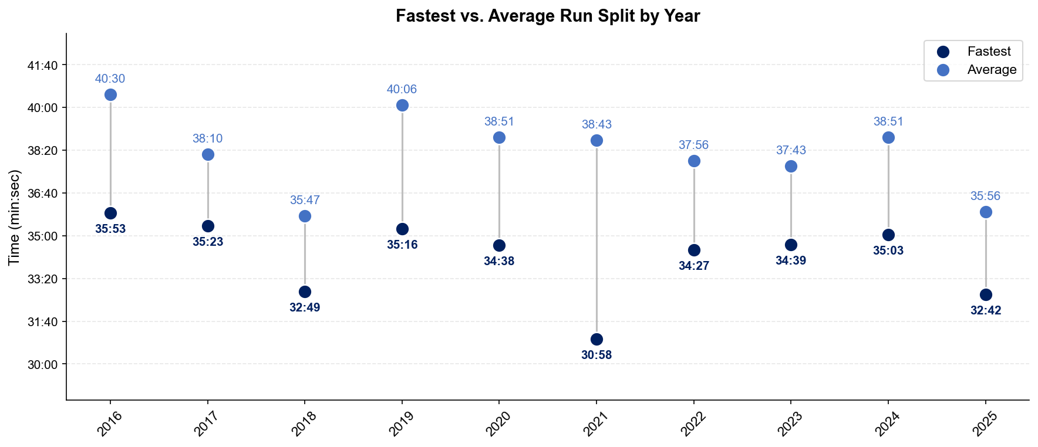
Run Split Analysis — Elite Women
Karlovy Vary

Slide 28
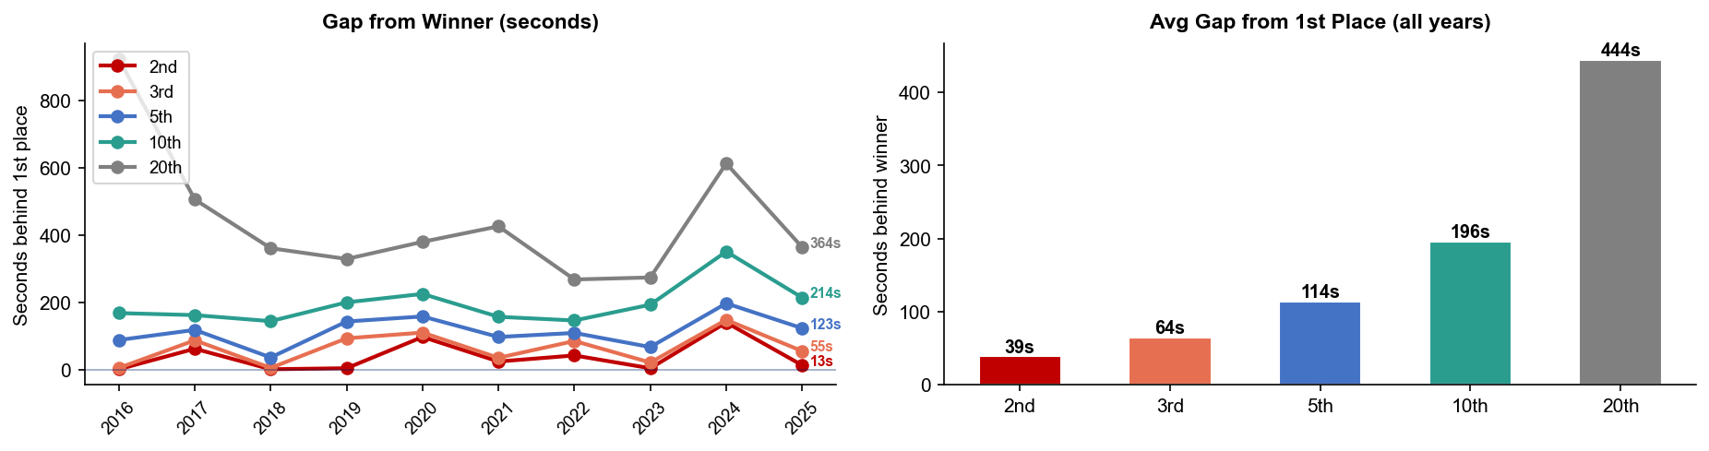
Key Position Times — Elite Women
Karlovy Vary
Year | 1st | 2nd | 3rd | 5th | 10th | 20th
2016 | 2:07:22 | 2:07:23 +1s | 2:07:27 +5s | 2:08:50 +88s | 2:10:10 +168s | 2:22:46 +924s
2017 | 2:03:29 | 2:04:31 +62s | 2:04:56 +87s | 2:05:27 +118s | 2:06:11 +162s | 2:11:55 +506s
2018 | 2:08:22 | 2:08:23 +1s | 2:08:27 +5s | 2:08:58 +36s | 2:10:46 +144s | 2:14:23 +361s
2019 | 2:09:08 | 2:09:12 +4s | 2:10:41 +93s | 2:11:31 +143s | 2:12:28 +200s | 2:14:37 +329s
2020 | 2:05:17 | 2:06:54 +97s | 2:07:07 +110s | 2:07:55 +158s | 2:09:02 +225s | 2:11:37 +380s
2021 | 2:06:56 | 2:07:20 +24s | 2:07:31 +35s | 2:08:33 +97s | 2:09:33 +157s | 2:14:02 +426s
2022 | 2:05:04 | 2:05:46 +42s | 2:06:29 +85s | 2:06:53 +109s | 2:07:30 +146s | 2:09:32 +268s
2023 | 2:03:51 | 2:03:55 +4s | 2:04:12 +21s | 2:04:58 +67s | 2:07:04 +193s | 2:08:25 +274s
2024 | 2:05:23 | 2:07:43 +140s | 2:07:51 +148s | 2:08:40 +197s | 2:11:14 +351s | 2:15:36 +613s
2025 | 2:02:12 | 2:02:25 +13s | 2:03:07 +55s | 2:04:15 +123s | 2:05:46 +214s | 2:08:16 +364s

Slide 29
Race Conditions — Elite Women
Karlovy Vary
Year | Date | Air Temp | Humidity | Wind (km/h) | Precip (mm) | Water Temp | Wetsuit | Conditions
2016 | Aug 28 | 25.8 | 52% | 8 | 0.0 | — | — | —
2017 | Sep 03 | 14.0 | 59% | 8 | 0.0 | — | — | —
2018 | Sep 01 | 15.8 | 60% | 15 | 0.0 | — | — | —
2019 | Aug 25 | 24.5 | 59% | 13 | 0.0 | — | — | —
2020 | Sep 13 | 21.8 | 50% | 7 | 0.0 | — | — | —
2021 | Sep 11 | 18.8 | 81% | 10 | 0.1 | — | — | —
2022 | Sep 11 | 16 | 60% | 12 | 0.1 | 19.1 | allowed | —
2023 | Sep 10 | 23.6 | 48% | 4 | 0.0 | 19 | allowed | —
2024 | Sep 08 | 19.8 | 46% | 8 | 0.0 | 23.2 | forbidden | —
2025 | Sep 14 | 14.6 | 81% | 13 | 0.6 | 18.1 | allowed | —
Air temp, humidity, wind, and precipitation sourced from Open-Meteo historical archive (race window 10:00–17:00 local) where WT API data is absent. Values marked * are Open-Meteo estimates. Water temp and wetsuit ruling are from the World Triathlon API per program.

